Slide 1
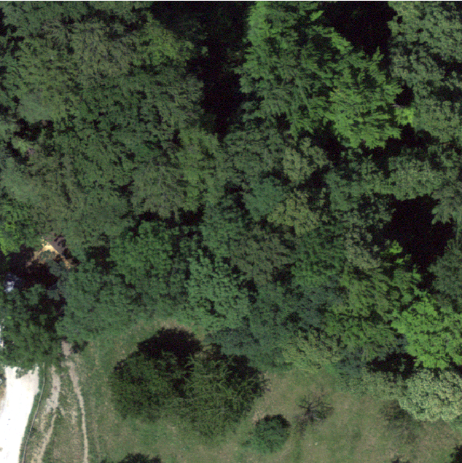
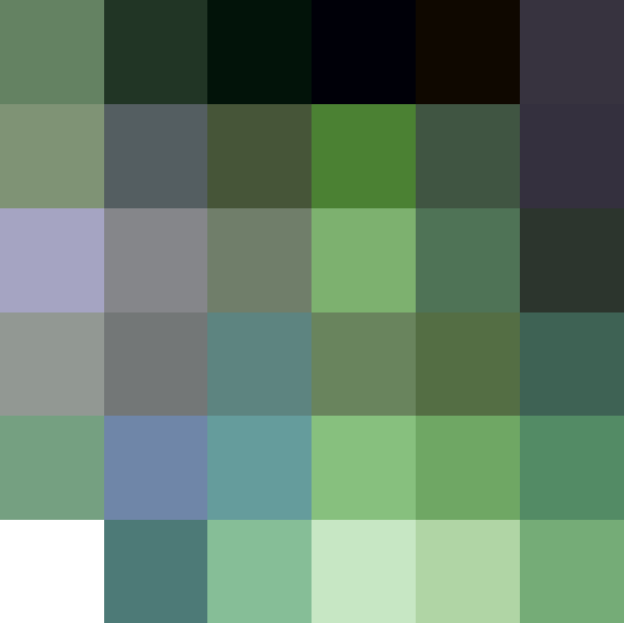


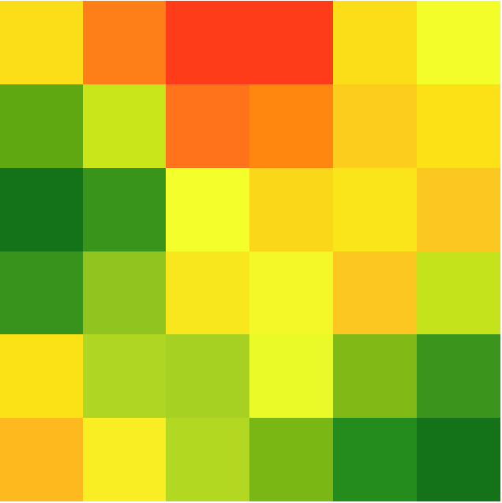
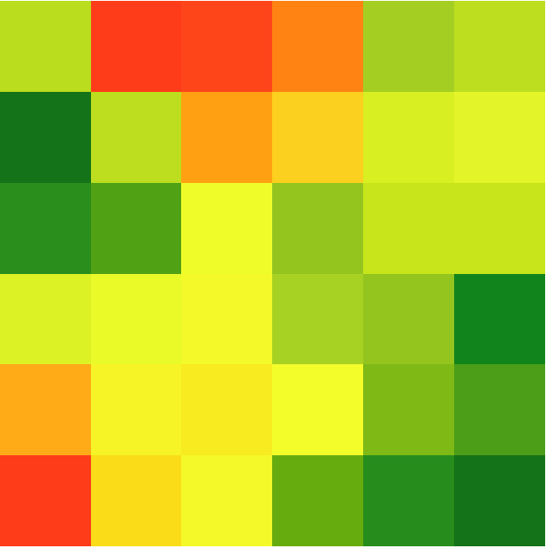
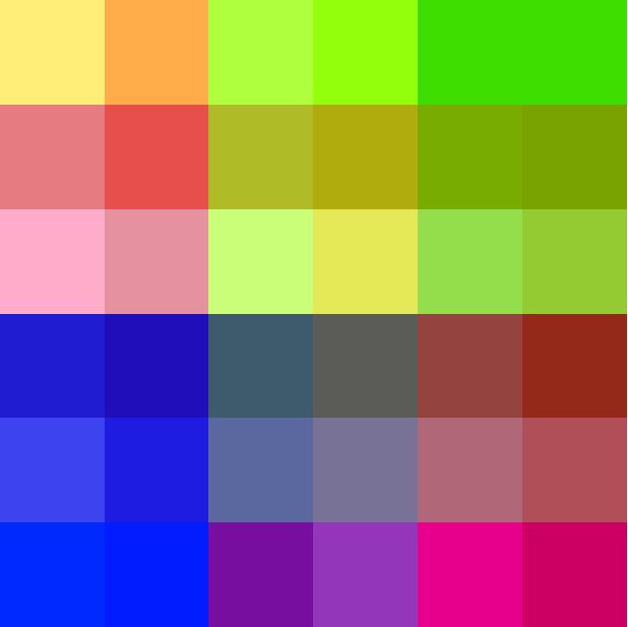


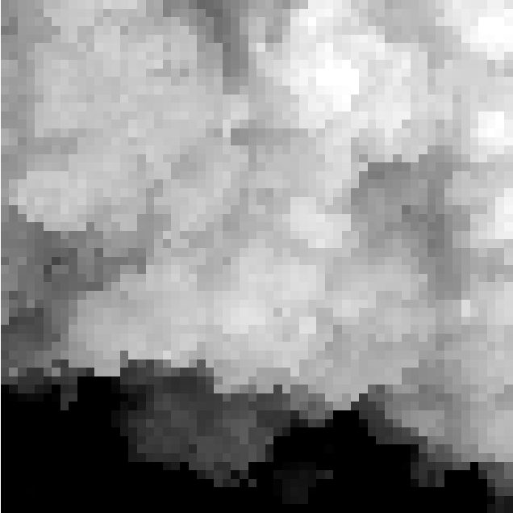
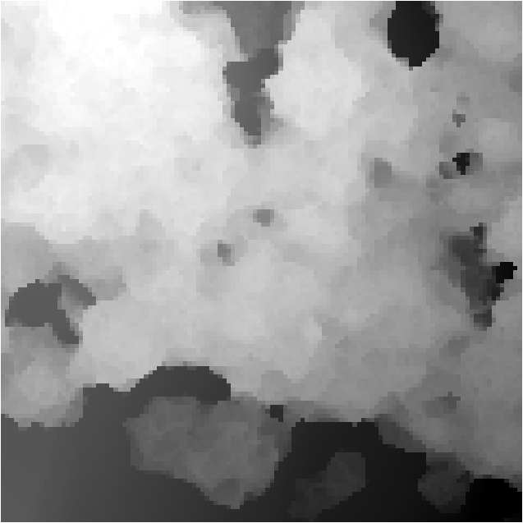









Resample
UAV Image
$\frac{H}{2}$ × $\frac{W}{2}$ @0.2m/px
Dense Feature Map
Downsample
H × W @0.1m/px
AnySat
$$ℝ^{256×30×30}$$
Sub-patch = 10m
Sentinel 2-TS
$$ℝ^{1536×30×30}$$
Gated Unit
$$P_{3}$$
Sub-patch = 10m
Sentinel 1-TS
$$P_{4}$$
DINO Detector
Google Satellite Embedding
$$P_{5}$$
VHM Encoder
$$P_{6}$$
DEM
FPN
VHM
DSM
Climplicit
broadcast
(Lat, Lon, Year)
…
…
$${embedding∈ℝ}^{256}$$
$$ℝ^{256×30×30}$$

